Slide 1
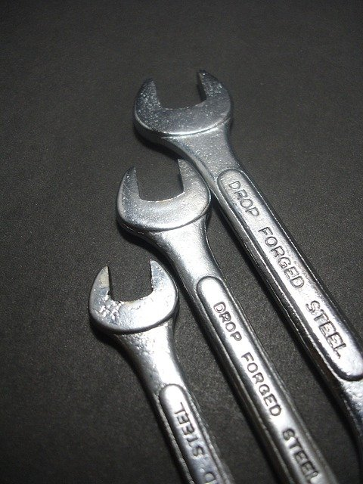
VEHICLE MANAGEMENT SYSTEM (VMS)
GROUP - 04

Slide 2

Our team members : 1. SHAON, INDROJIT DHE (ID: 18-38674-3) 2. Nabajit Dey (ID: 19-40618-1) 3. Pranto Saha (ID: 18-38805-3) 4. Sakib-Ul-Ahsan (ID: 20-42978-1)

Slide 3

PROPOSAL PART

Slide 4
1. Does the project have a clear target market or audience? => Yes, our project have a clear target market and audience also. We will add some new features in our software. Our unique features are Emergency customer support in the road, being able to buy every vehicle equipment and etc. Other companies do not have these features. But with these we will target the market. Also, we will target audience. We will give them standard equipment and emergency call support. Also by using our features, they will save their valuable time.

Slide 5
For emergency support, first they will call us. Then we will send our service on the spot. We will provide 24 hours service. Moreover, the scope of work of garage owners will increase through our software. The software will be easily accessible. The peoples from the age of 20 to 65 years old will use the application. By using this application, both customers and garage mechanics can save their necessary time.

Slide 6
2. Does the team demonstrate a thorough understanding of the need, problem or opportunity, including evidence of research into the need, problem or opportunity? => Yes, Our team demonstrate a thorough understanding of the need, problem or opportunity, including evidence of research into the need, problem or opportunity. We will always give priority to the needs of the customer. We will give maximum solution to their problems. Our team will always research new features. Then we will add new successful features. If we have a problem, we will try to solve it quickly.

Slide 7
3. Define the project’s purpose and basic functionality easily in an understandable way? => Our main purpose is to provide maximum benefits to the customer through online support. We provides 360-degree vehicle solutions & on-demand emergency repair services. In our app, there will be a login page. Customers and garage owners will create their accounts here. Each account will be an individual account, and the account database for the customers, garage owners and admin panel will be different. Everyone can use every required feature for them. The website of the company will connect the software. After a successful login, a customer can choose any options, like - Home & On-road Emergency repair Support, Vehicle Health Consultancy, Vehicle Parts e-commerce platform and they can check the nearest garage from their location.

Slide 8
On the other hand, the garage owner or manager who will use the app to communicate with the customers can quickly locate where the customer is. Whether the customer will come to the garage or they need to send a mechanic if it is an on-road emergency repair. Mobile data or wi-fi will be needed to use the application. The software will connect the company's chat bot so that anyone can check their car or bike problems using the bot. In addition to these, there are several other benefits.

Slide 9
USE CASE DIAGRAM

Slide 10
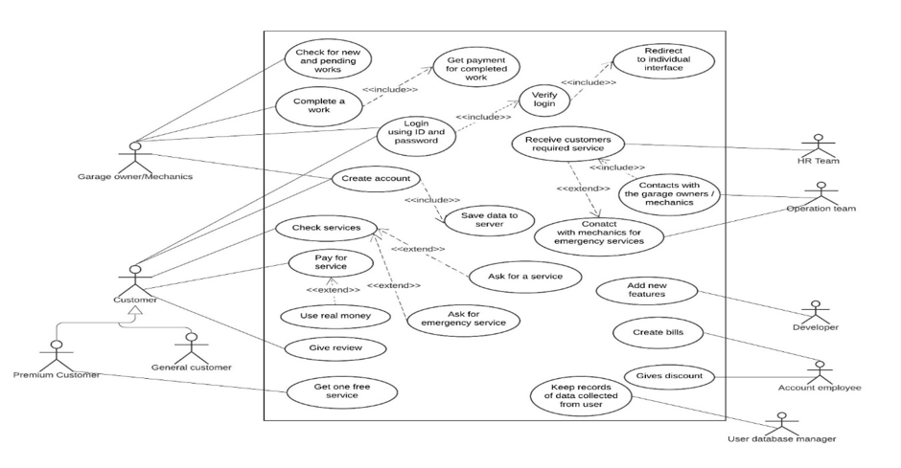

Slide 11
1. Use Case: Working and payment process 2. Author: Group-4 3. Date: 01 October, 2021 4. Purpose: To provide customer service, emergency service and clear discussion about payment process.

Slide 12
5. Overview: " Vehicle Management System " is an online platform that provides 360-degree vehicle solutions & on-demand emergency repair services. With the motto of being the roadside best friends, they want to create the biggest innovative revolution in the automobile industry within five years. They want to build an application for their customers and garage owners to manage everything efficiently. In their app, there will be a login page. If the customer or garage owner already have an account they can sign in; Otherwise, they have to create an account. Each account will be an individual account, and the account database for the customers, garage owners and admin panel will be different. With a single application, everyone can use every required feature for them. The website of the company will connect the software. After a successful login, a customer can choose any options, like - Home & On-road Emergency repair Support, Vehicle Health Consultancy, Vehicle Parts e-commerce platform and they can check the nearest garage from their location.

Slide 13
On the other hand, the garage owner or manager who will use the app to communicate with the customers can quickly locate where the customer is. Whether the customer will come to the garage or they need to send a mechanic if it is an on-road emergency repair or else what should a garage manager or owner know. Admins of that company can also log in and check everything about the app. The company will update the software after some specific time for next five years depending on the customer feedback and upcoming new services. Mobile data or wifi will be needed to use the application. There will be some options for payment. The customers can use e-banking system for payment, or they can choose cash. They can buy automobile-related products using the app, and they can also pay using e-banking or cash on delivery. The software will connect the company's chat bot so that anyone can check their car or bike problems using the bot. They can detect a problem by themselves.

Slide 14
6. Actors: Customer (Premium, General), Garage owners/Mechanics, HR Team, Operation Team, Developer, Account employee, User database manager.

Slide 15
7. Pre-Condition: - Customer and Garage owner must have an account. - The garage owners must provide updates on his services in software. - HR team must accept the customer request - The account employee has to create the bill

Slide 16
8. Post Condition: - After successful login, the customer needs to be given specific directions for the desired service. - The customer will choose the payment method - The developer will add new features for software

Slide 17
9. Typical Course of events:
Actor Actions | System Actions
1. Begins when a customer face vehicle related problem.
2. Then customer open the app and logs in to the account. | 3. The System verifies the customer ID and Password.
4. After a successful login, a customer go to service option and choose any service options.
5. HR team receives customer’s required service | 6. The System sends information to the operation team
7. Operation team contacts with garage owners. | 8. Also the system sends customer’s required info to garage owners.
9. Then garage owners completes fixed work for customer. | 10. The System sends work’s info to account employee
11. Account employee creates the bill and sends it to the customer.
12. Customer pays the bill | 13. The System confirms customer’s bill
14. User data management Saves all processing

Slide 18
10. Alternative flow of events: - Step 3: Customer verification failed. Display an error message, cancel login step. - Step 7: Garage owner refuse the service. Operation team sends message HR team and HR team inform to customer. - Step12: Customer failed to Payment. The bill has been added to the customer's loan repayment section.

Slide 19
11. Exceptional flow of events: - System failure in the process before step 3 or 6 or 8 or 10; cancel the next step

Slide 20
USER STORY

Slide 21
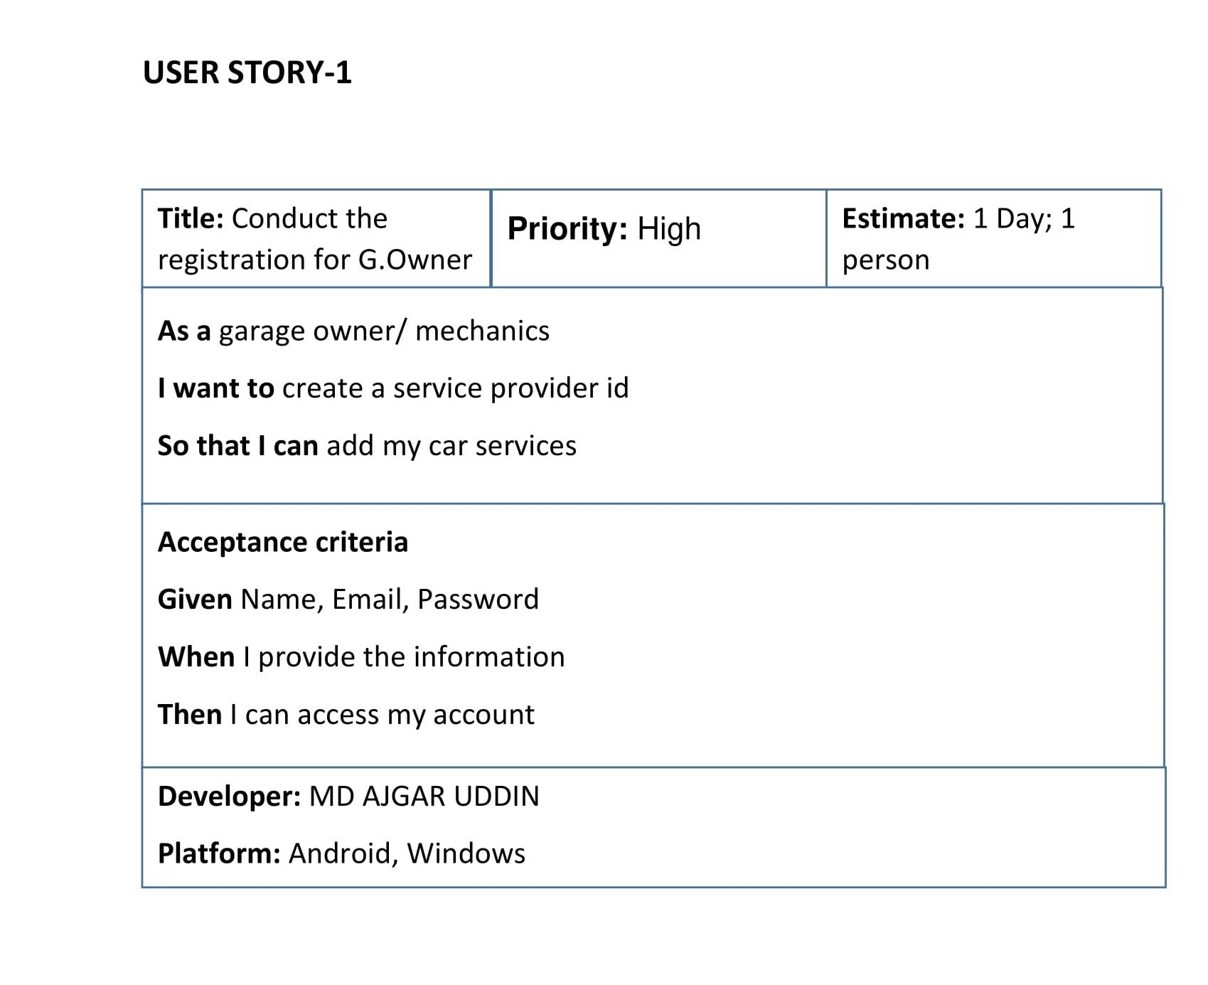

Slide 22
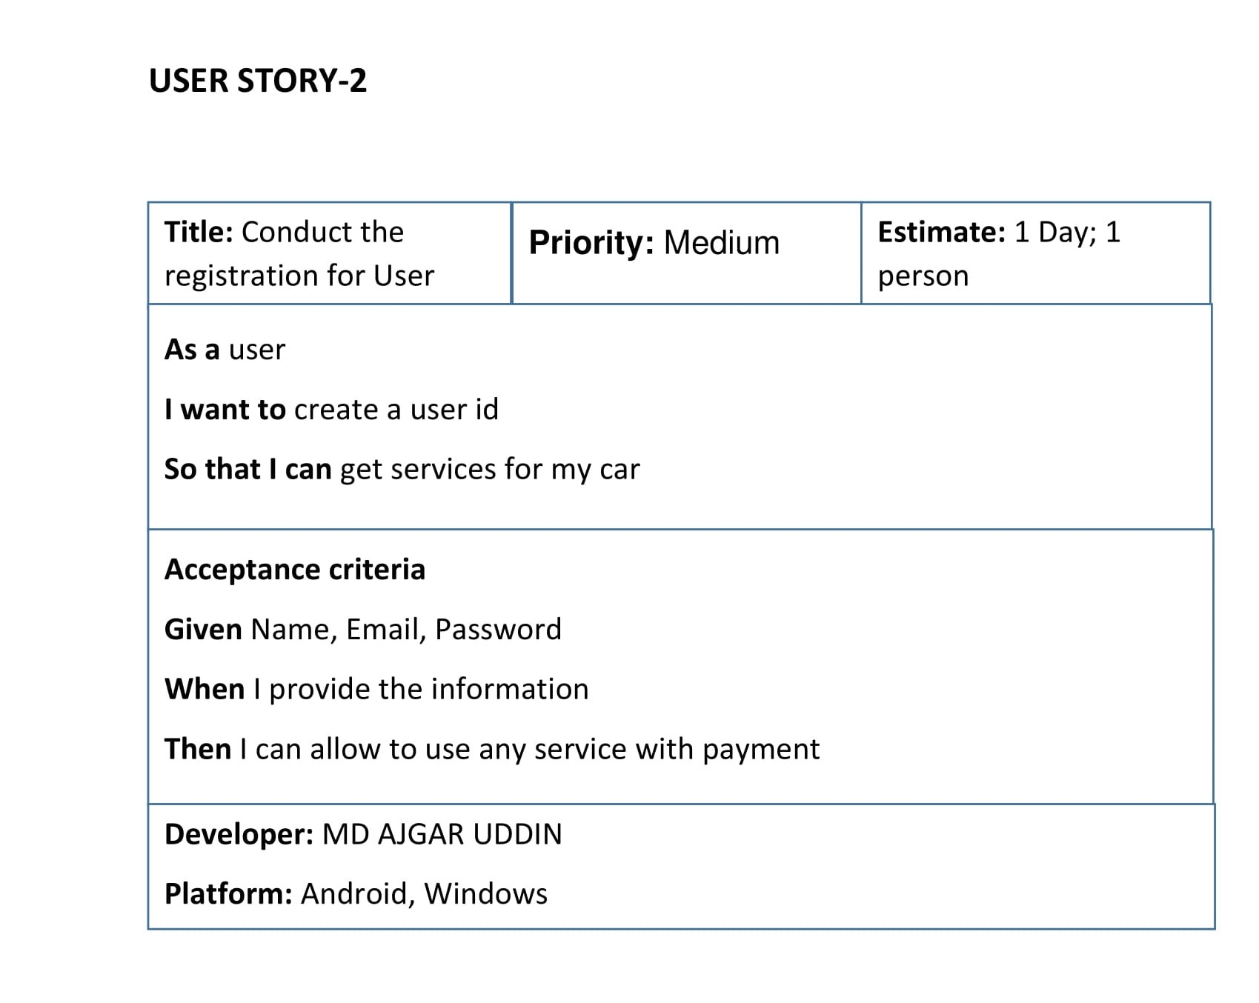

Slide 23
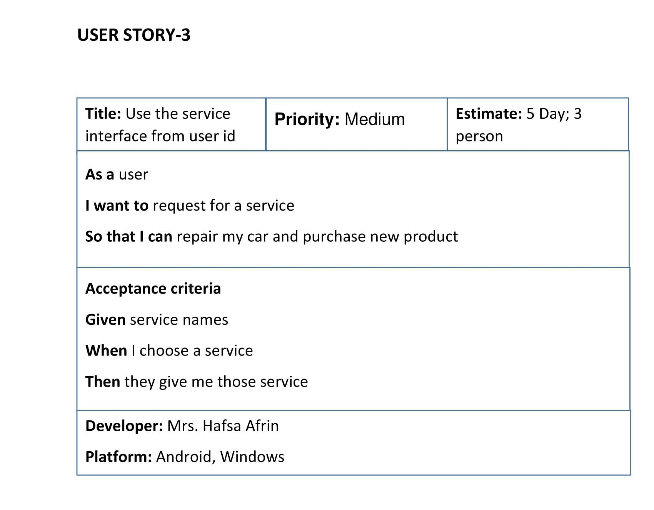

Slide 24
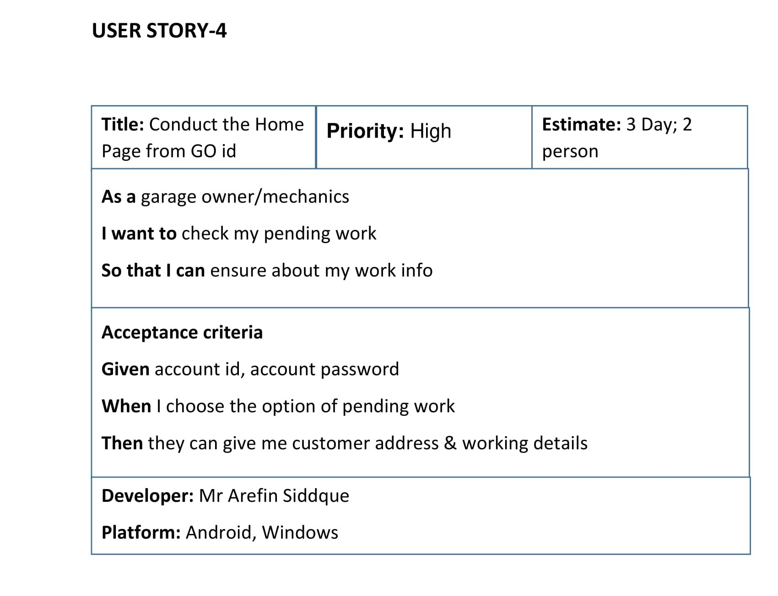

Slide 25
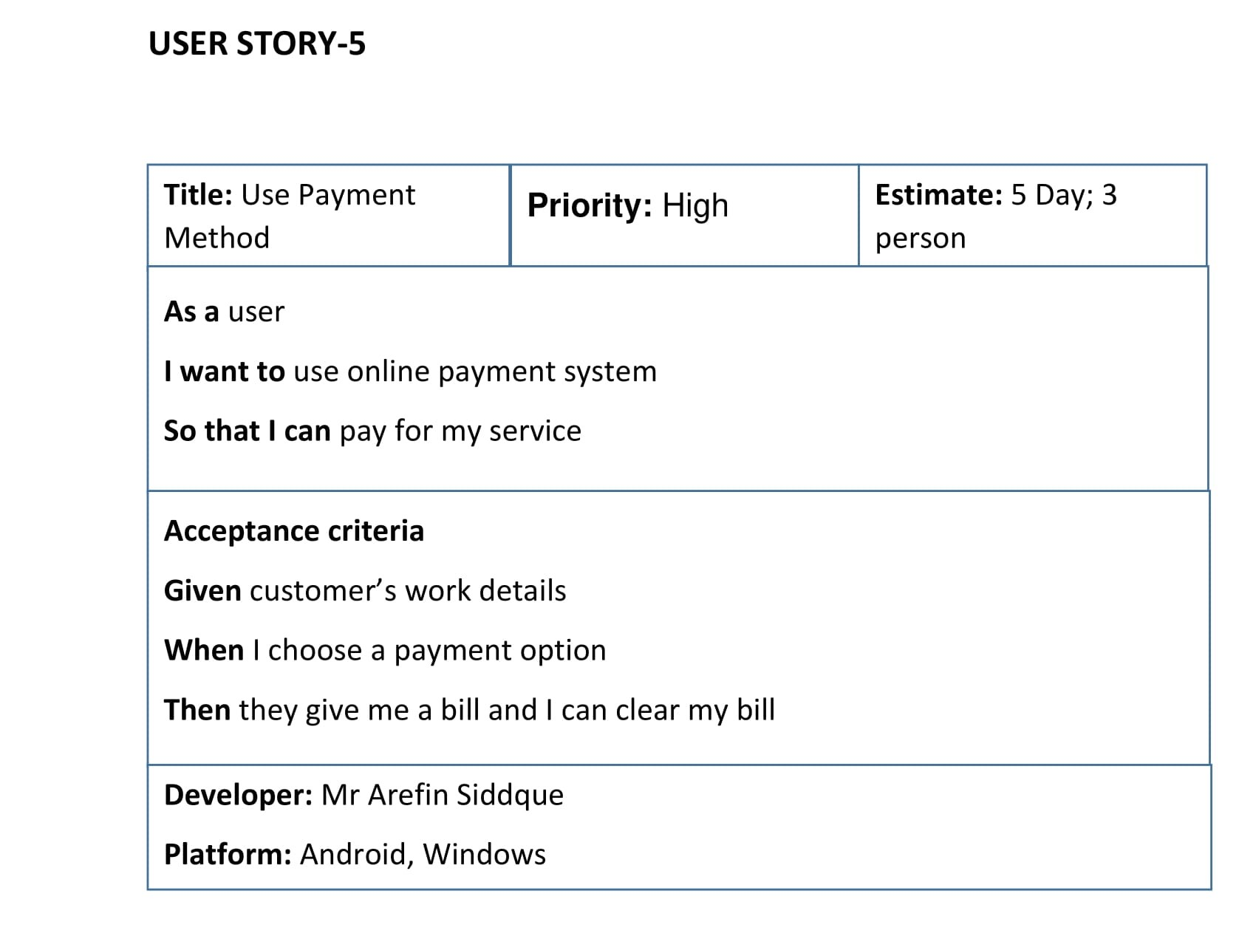

Slide 26
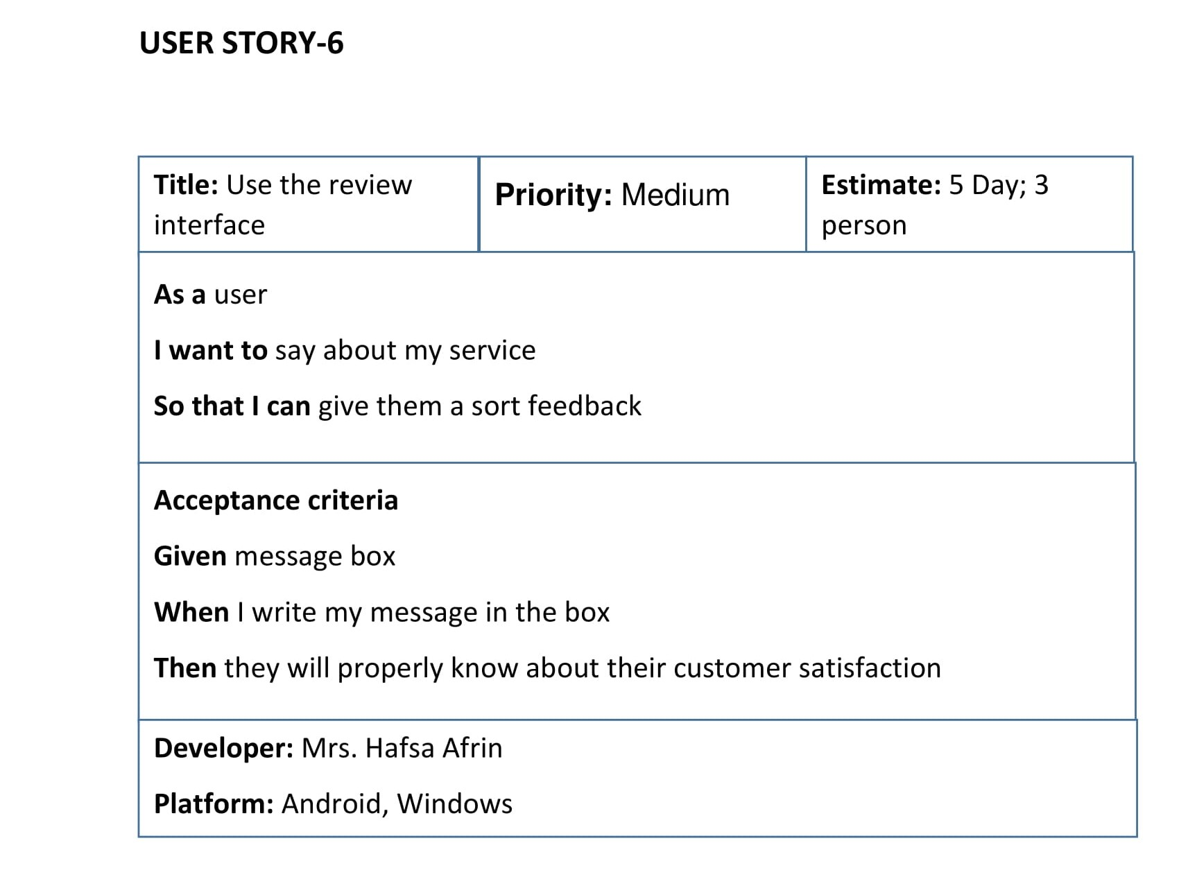

Slide 27
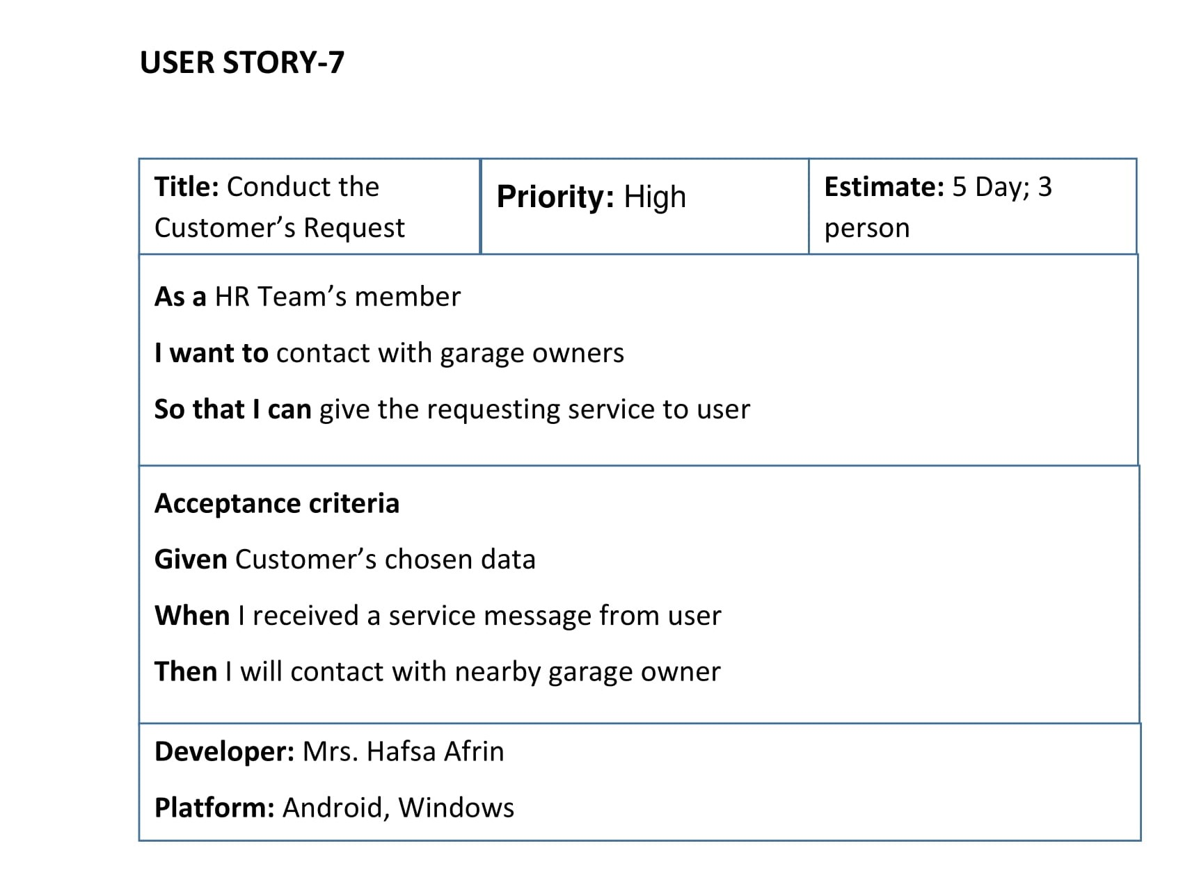

Slide 28
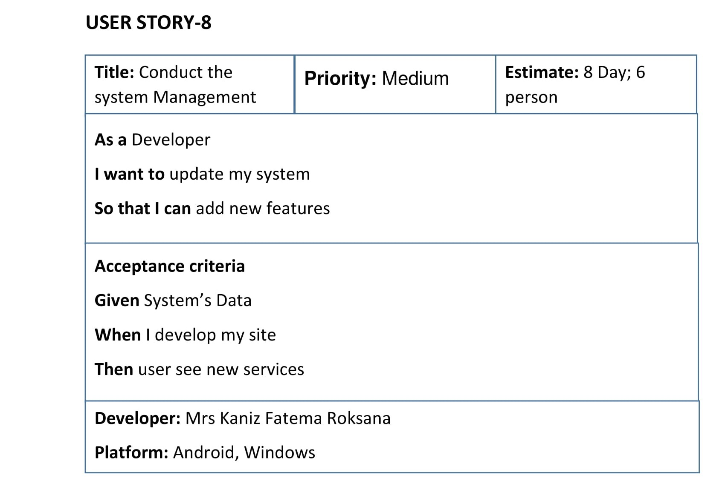

Slide 29
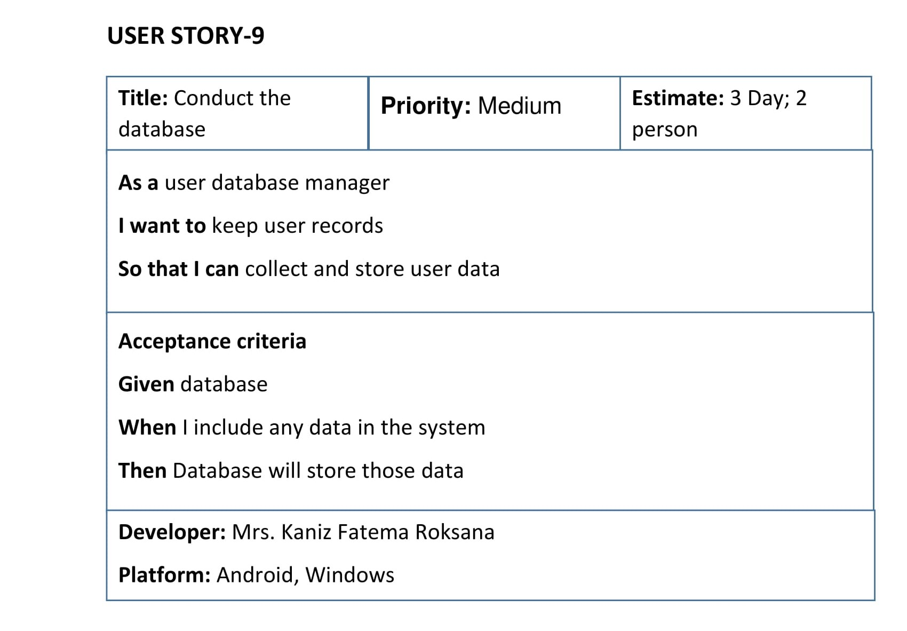

Slide 30
USER INTERFACE (UI)
*** Some of our Project’s UI interface:

Slide 31
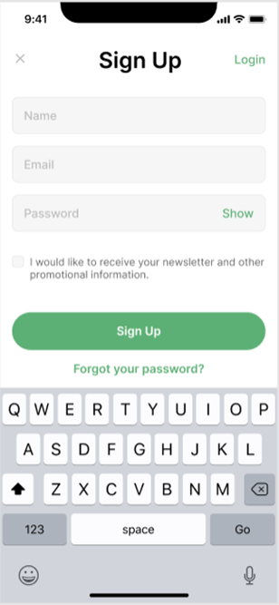
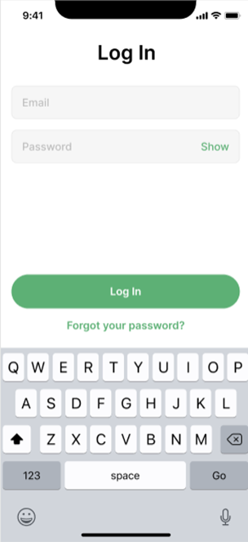

Slide 32
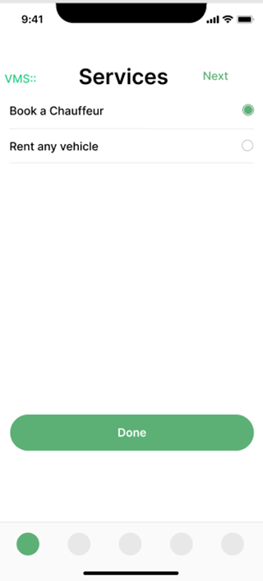
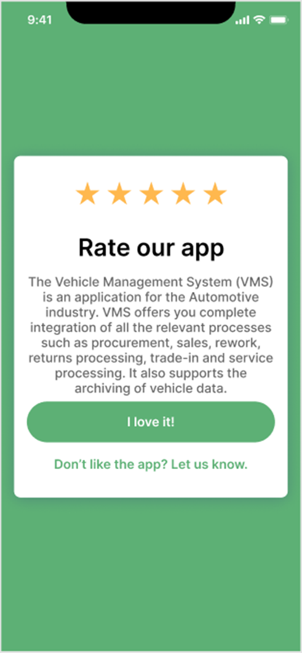

Slide 33
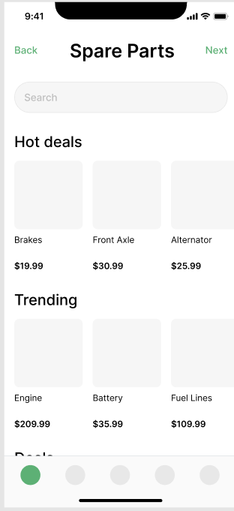

Slide 34
ACTIVITY DIAGRAM

Slide 35
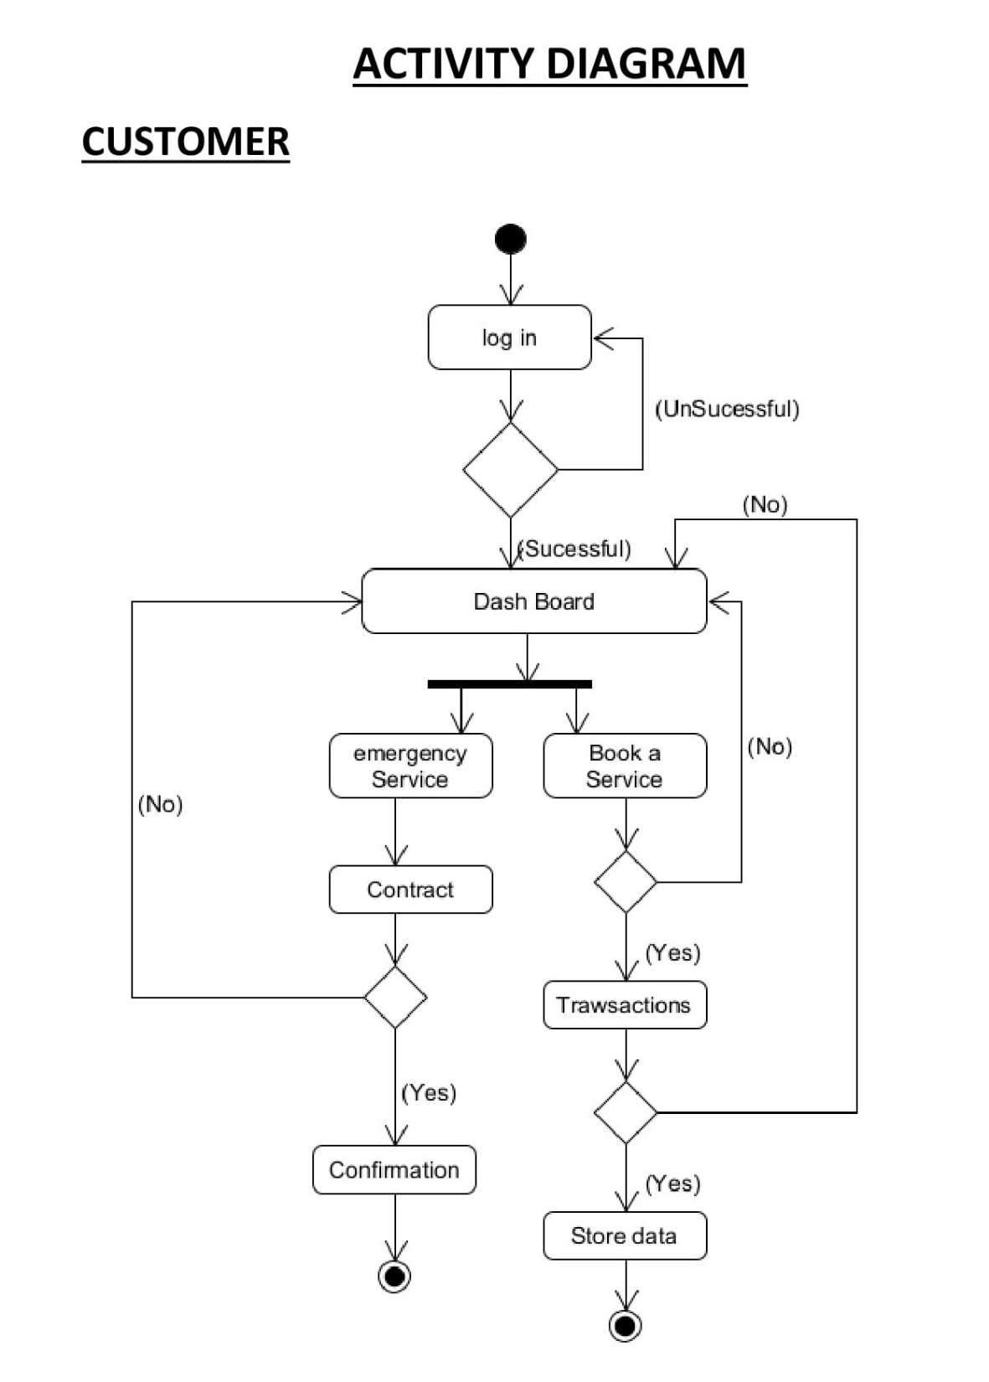
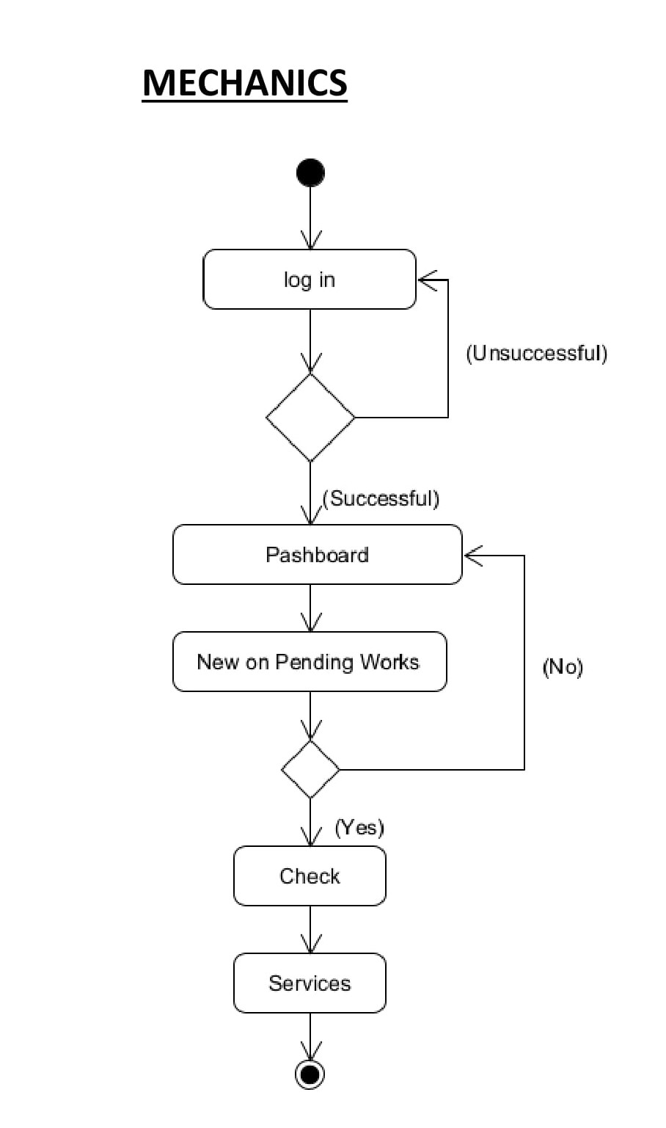

Slide 36
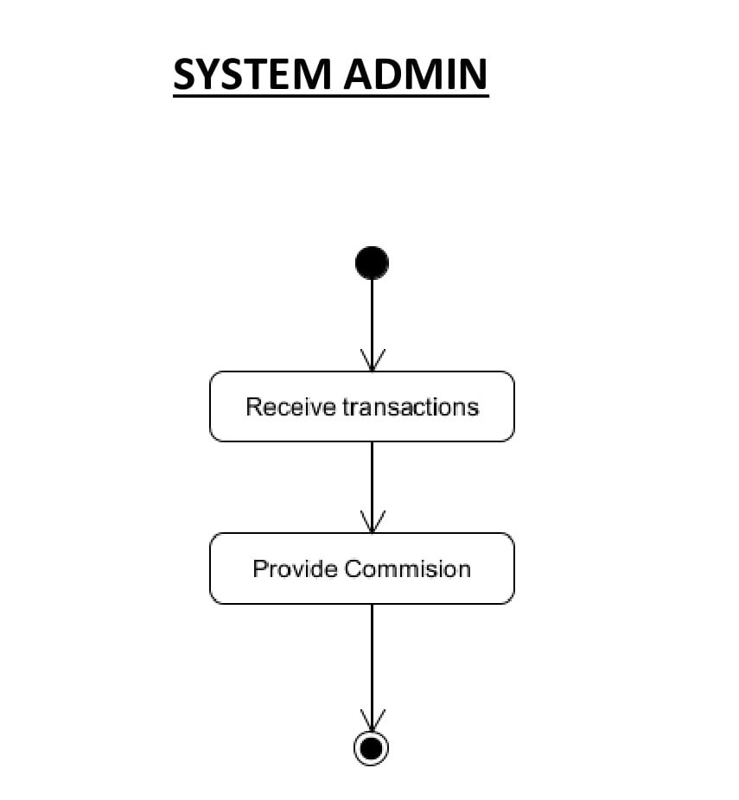
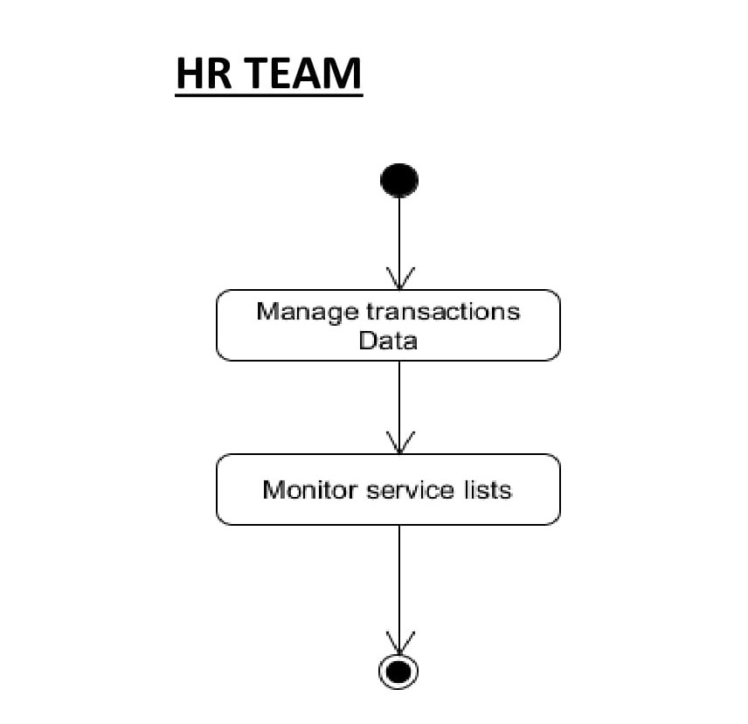

Slide 37
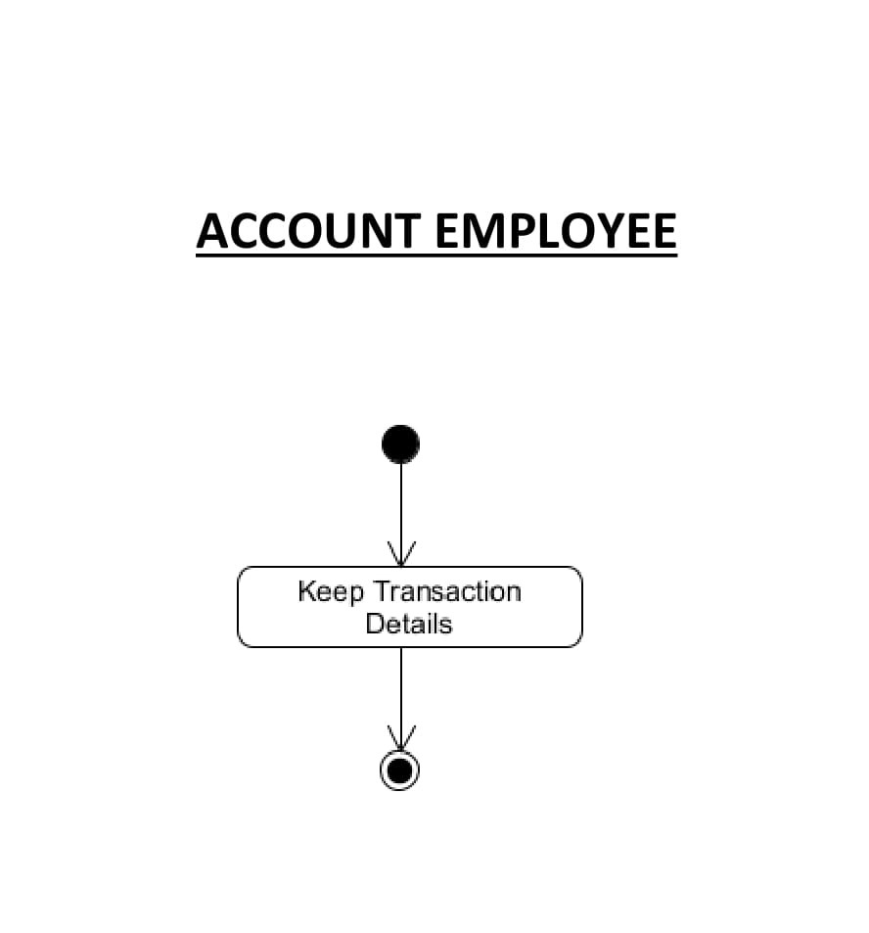

Slide 38
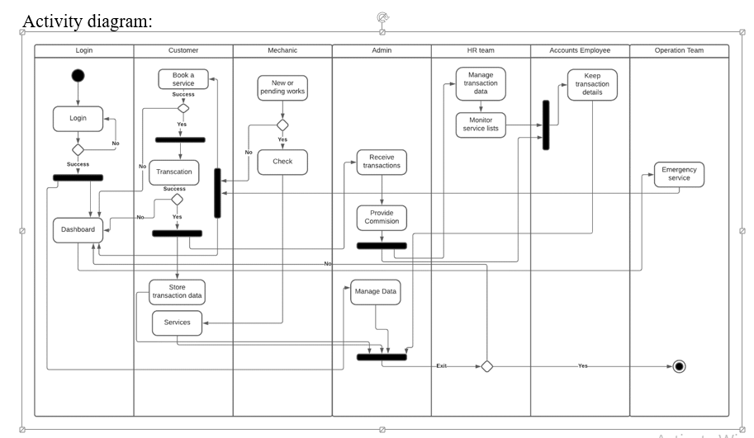

Slide 39
CRC

Slide 40
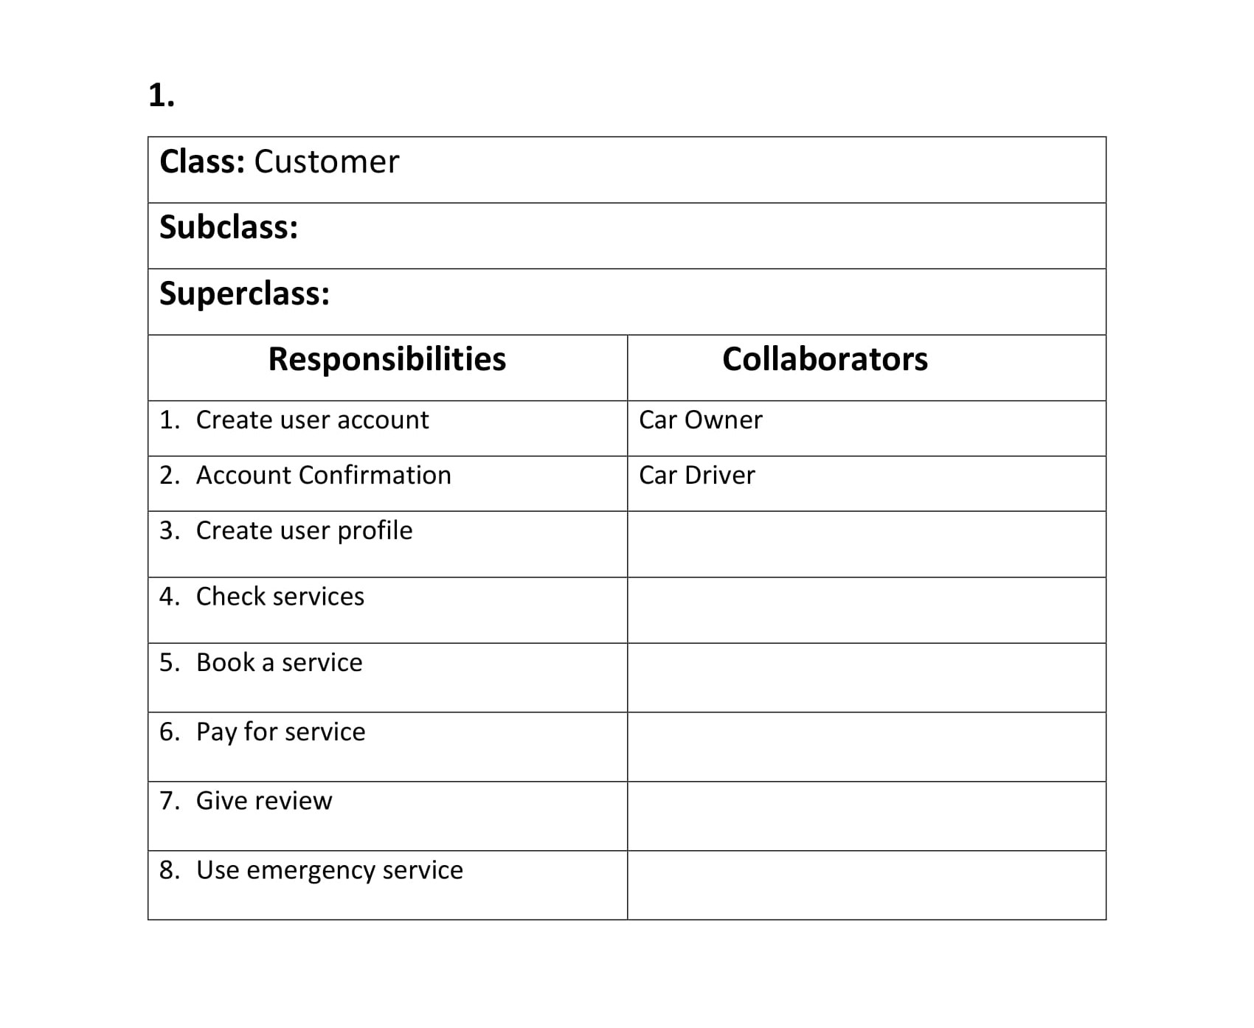

Slide 41
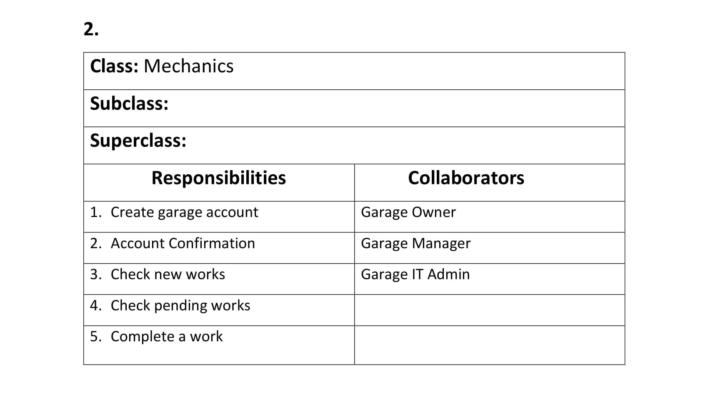

Slide 42
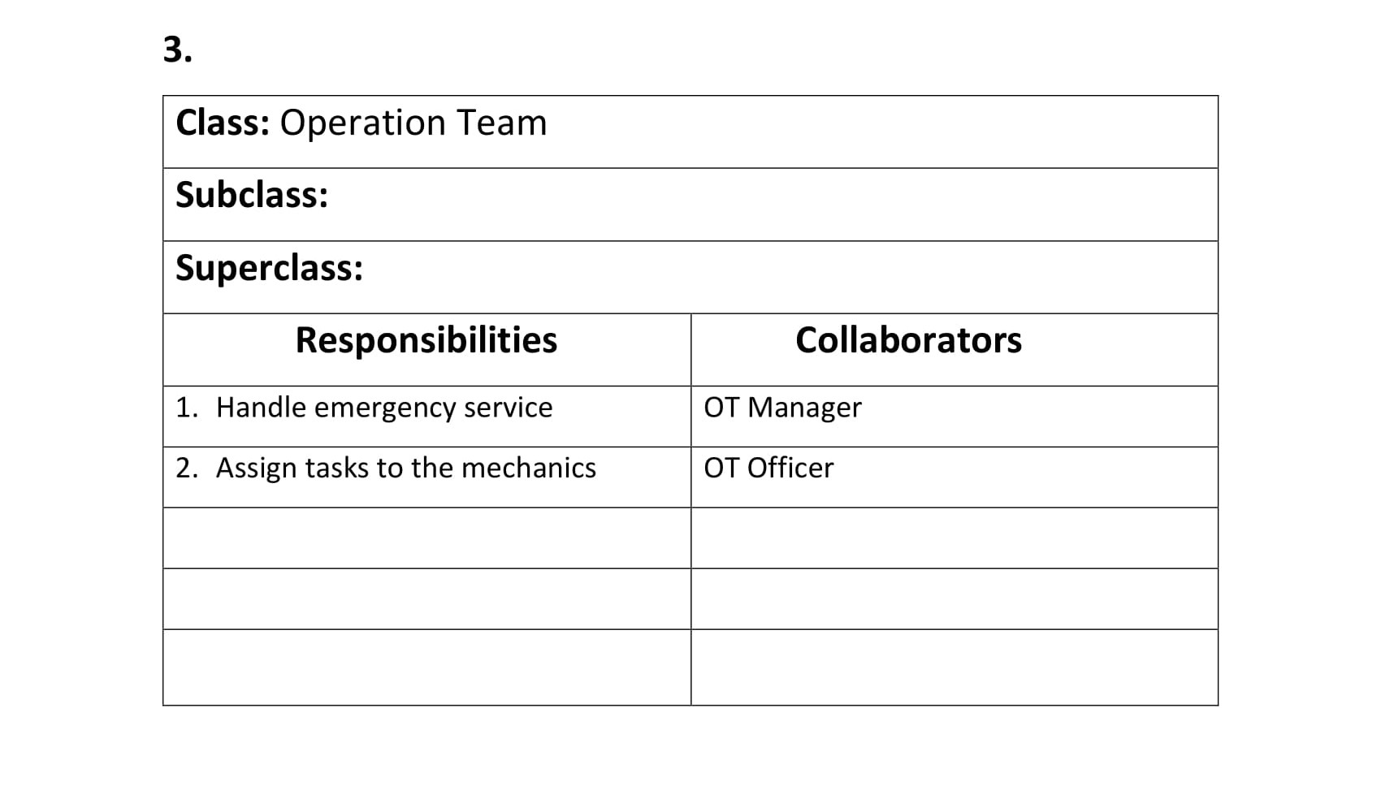

Slide 43
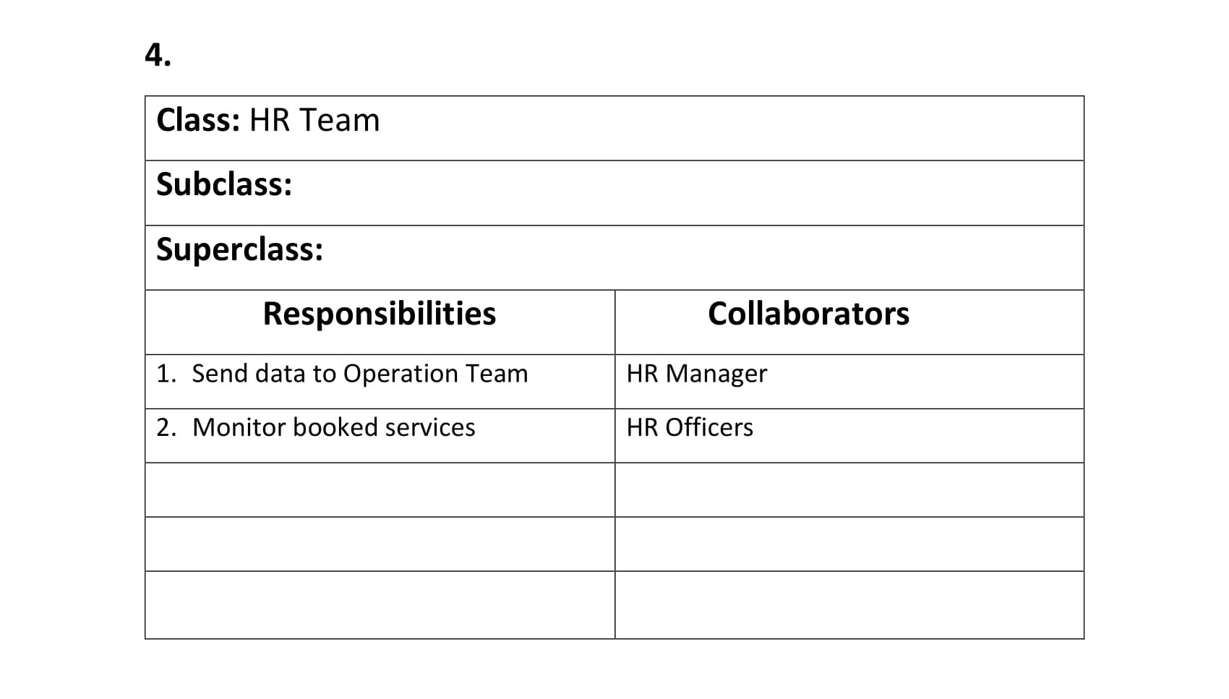

Slide 44
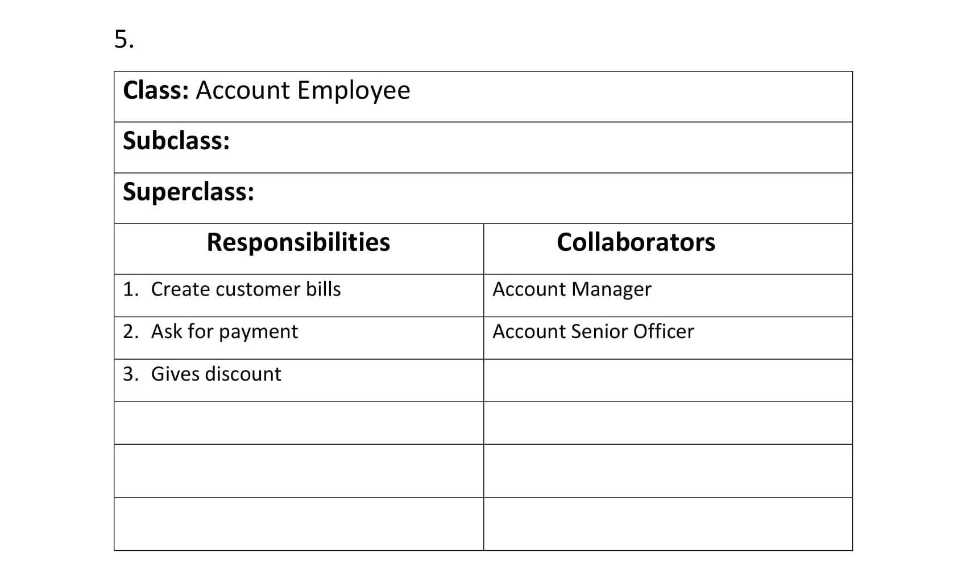

Slide 45
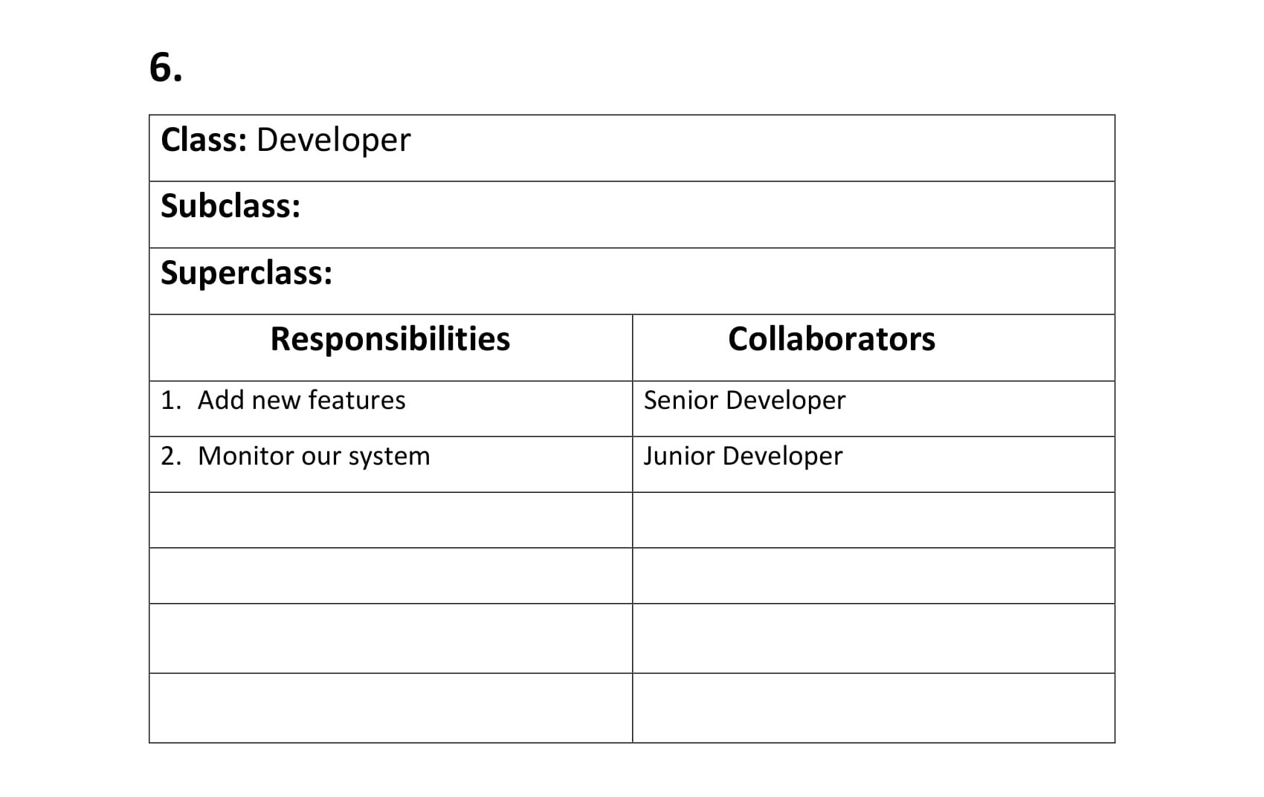

Slide 46
CLASS COMPARTMENTS

Slide 47
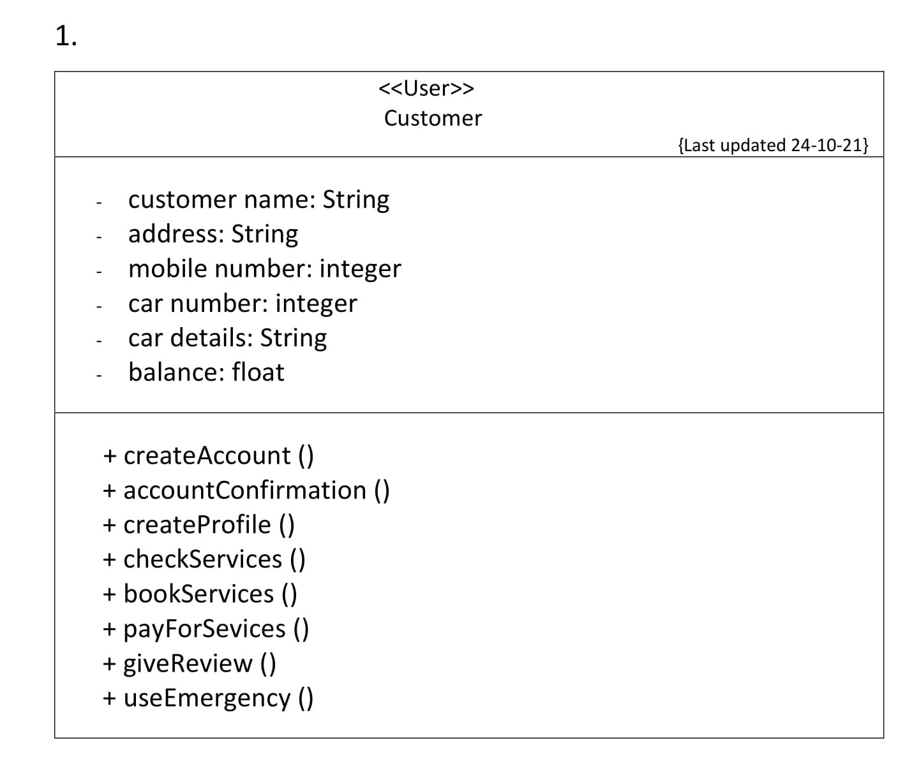

Slide 48
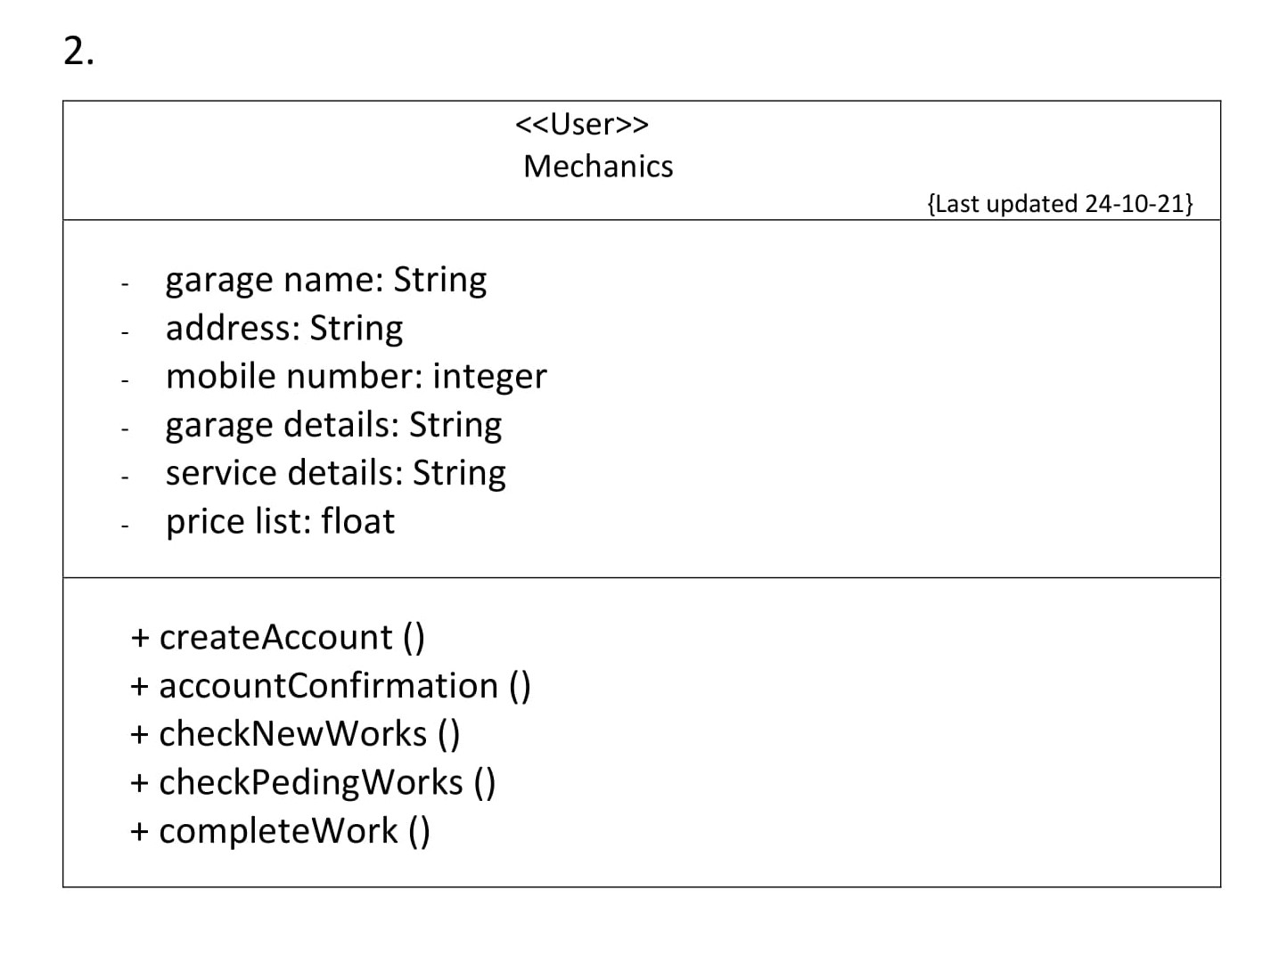

Slide 49
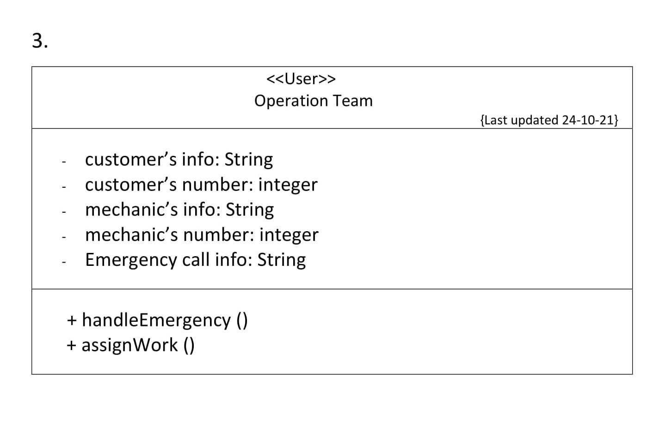

Slide 50
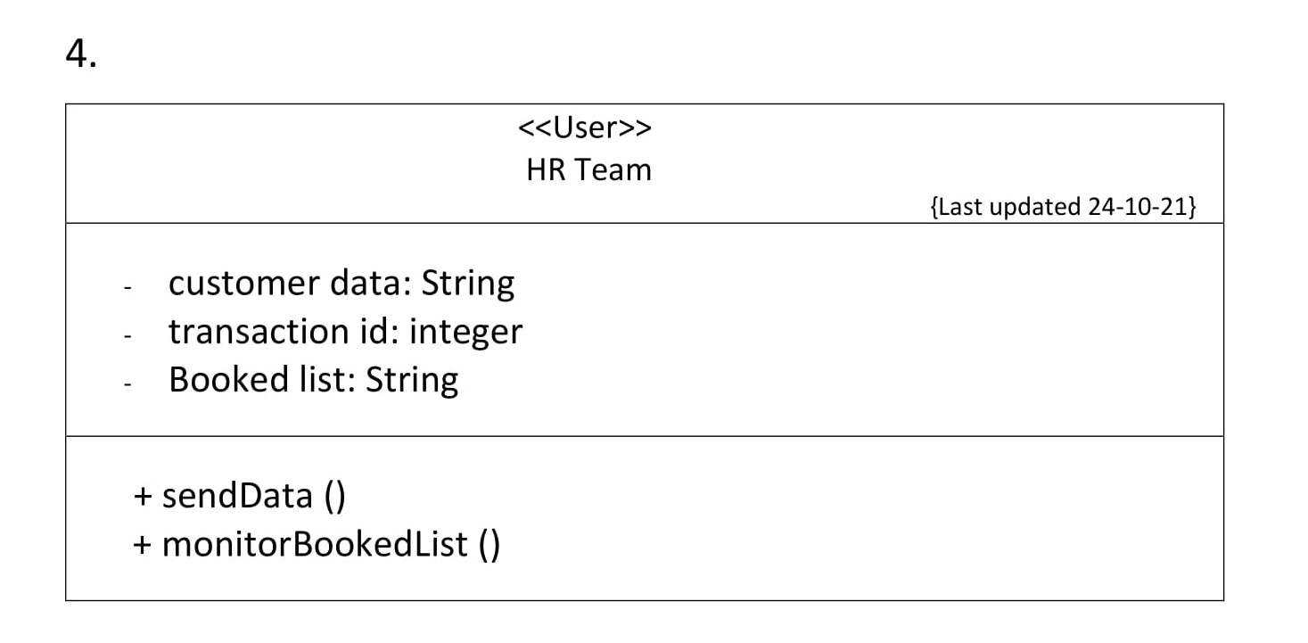

Slide 51
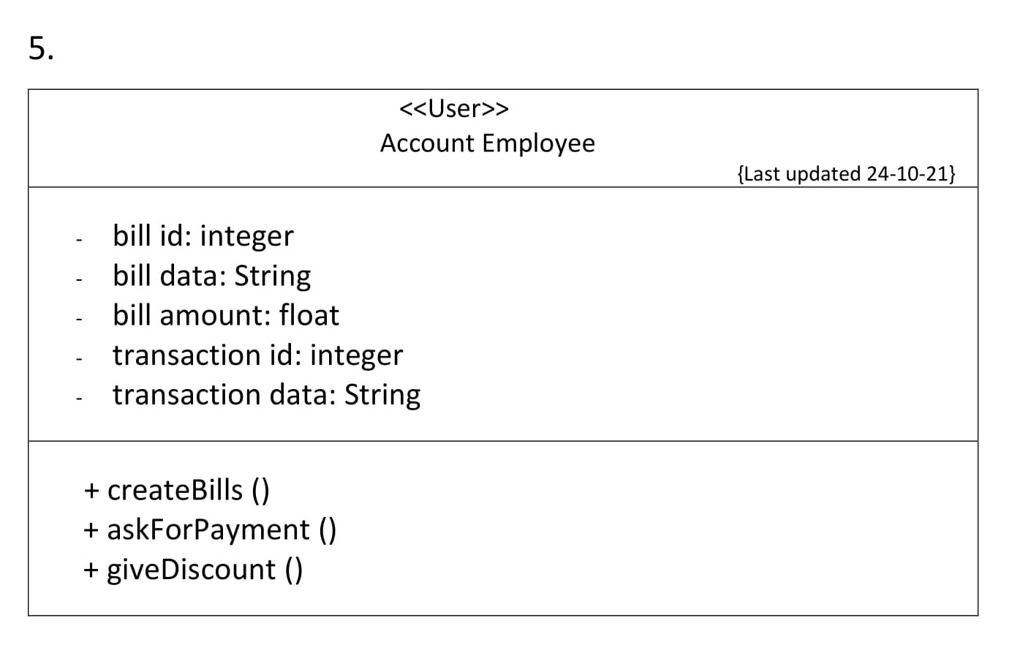

Slide 52
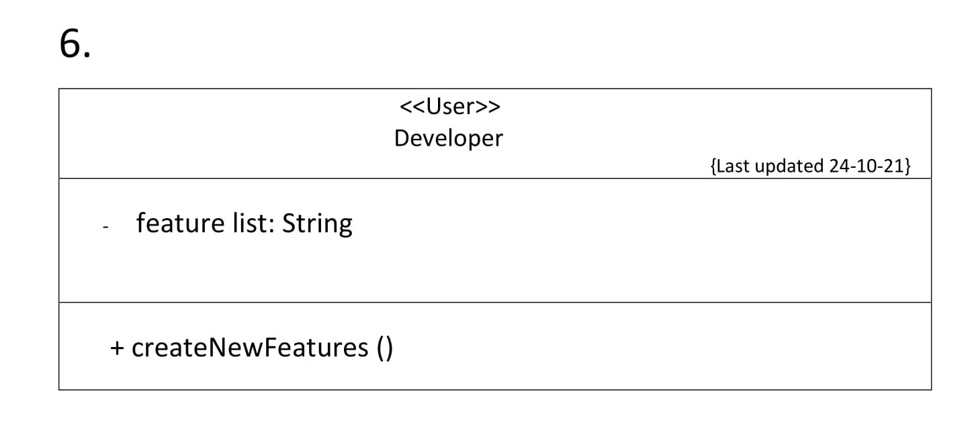

Slide 53
JIRA

Slide 54
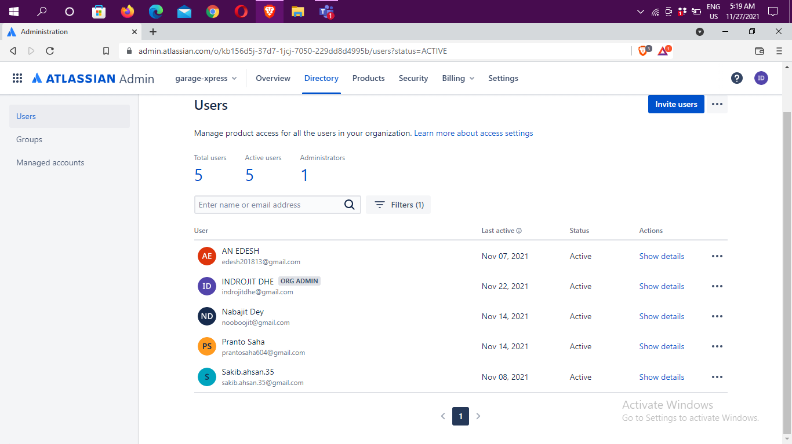

Slide 55
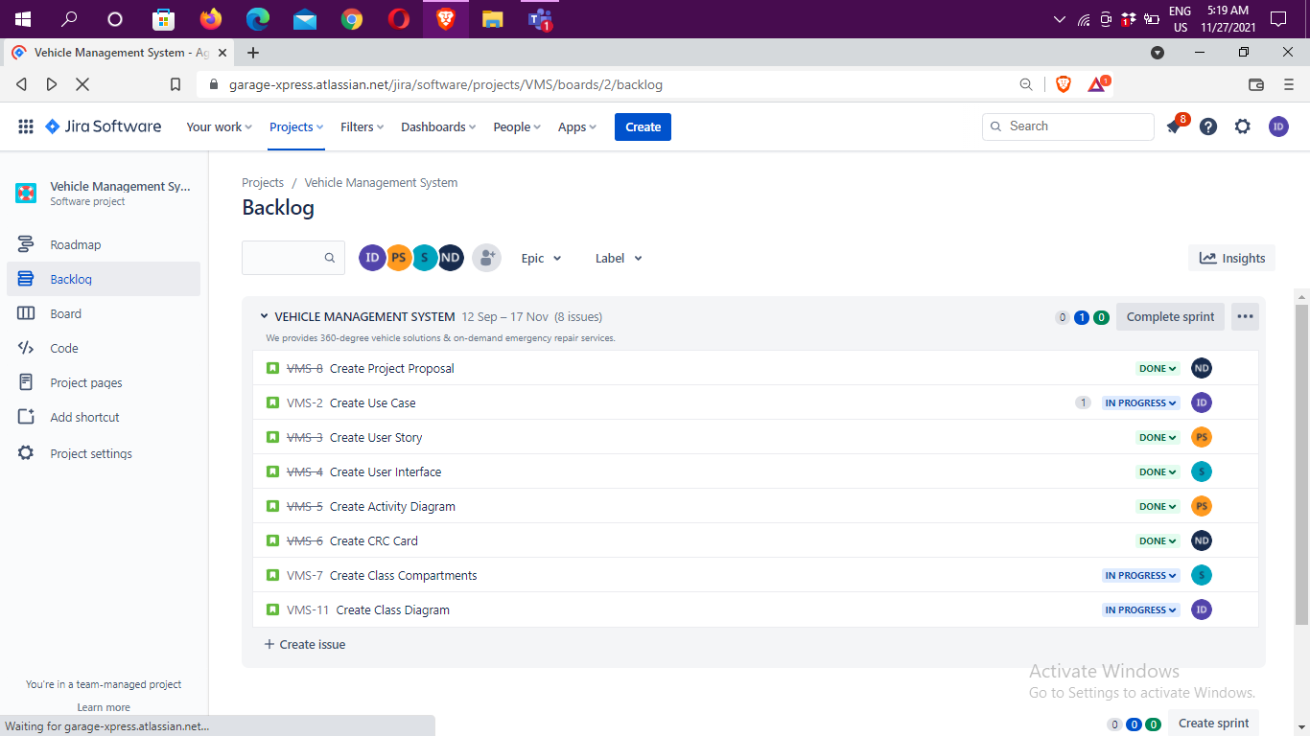

Slide 56
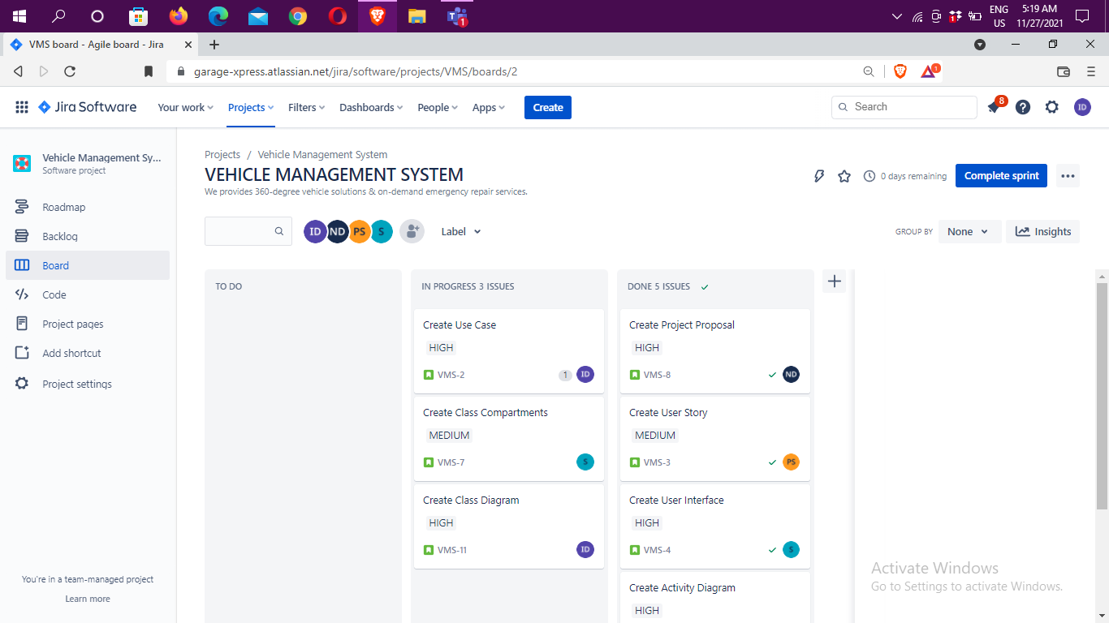

Slide 57
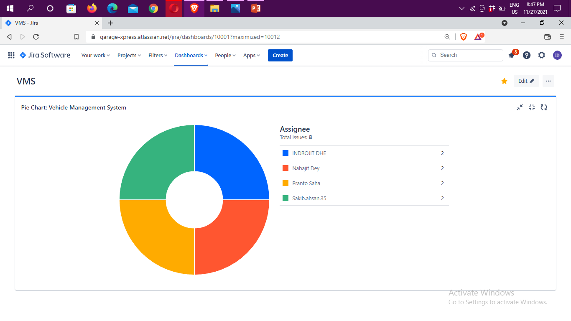

Slide 58
PROJECT STATEMENT

Slide 59
• Our company is maintaining many mechanics with garages by online. They provide vehicle service, emergency road service, purchase vehicle service, car wash service to customers. The customer must book in advance to get any services without emergency. Then the garage authorities have to confirm it. Actually, after a successful login, a customer can choose any options, like - Home & On-road Emergency repair Support, Vehicle Health Consultancy, Vehicle Parts e-commerce platform and they can check the nearest garage from their location. On the other hand, the garage owner or manager who will use the app to communicate with the customers can quickly locate where the customer is. Our software will connect the company's chat bot so that anyone can check their car or bike problems using the bot. In addition to these, there are several other benefits.

Slide 60
• Our HR Team check booked lists and send to Operation Team. Operation Team assign wok to mechanics and handle emergency services. Our developer add new features. Our account employee create bills and gives discount. Also ask for payment. We need a system for communicate and control our employee and garage mechanics.

Slide 61
CLASS DIAGRAM

Slide 62
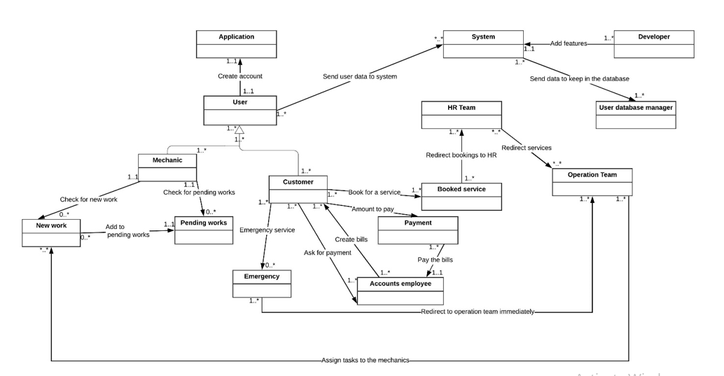

Slide 63
GITHUB

Slide 64
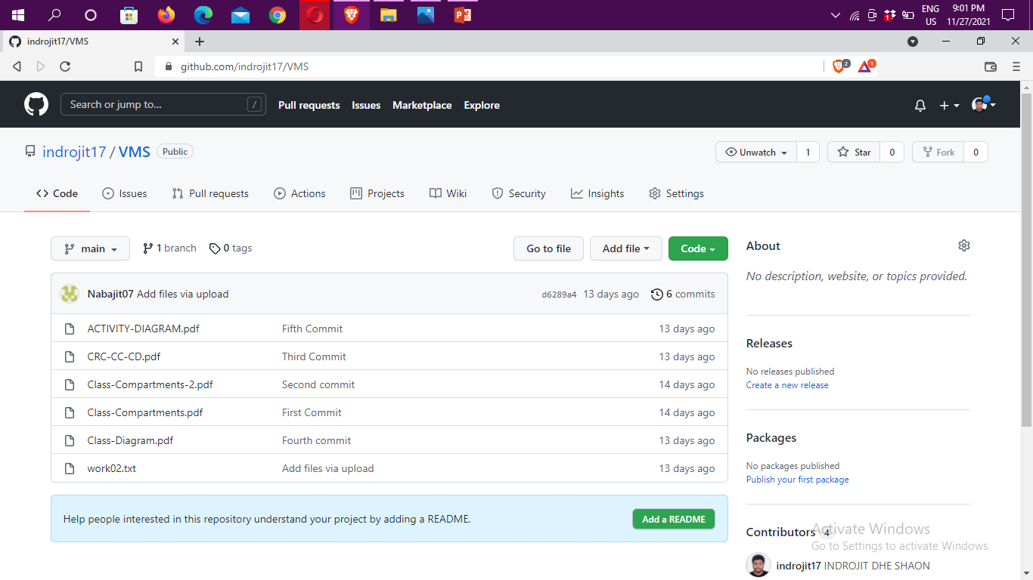

Slide 65
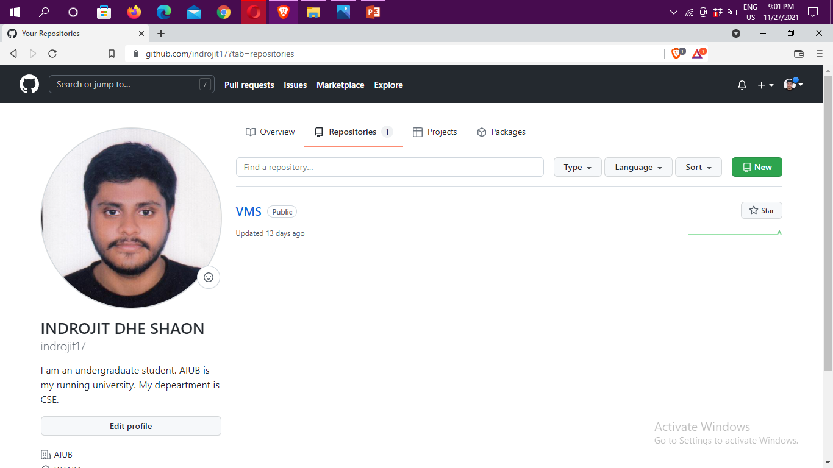

Slide 66
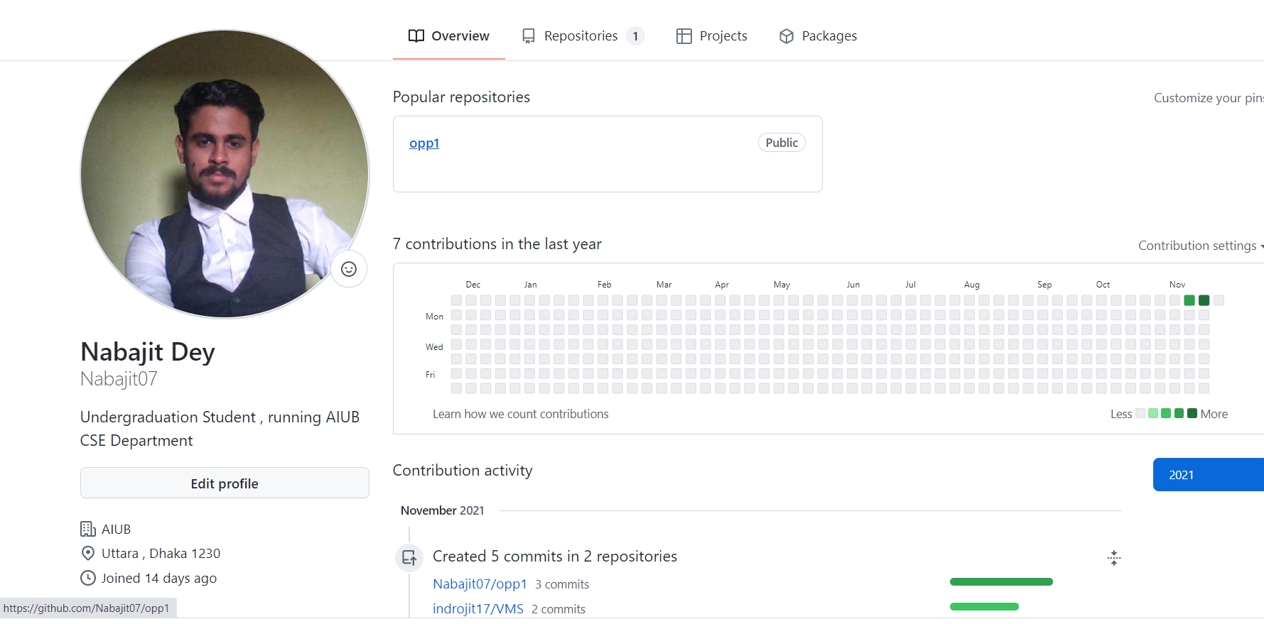

Slide 67
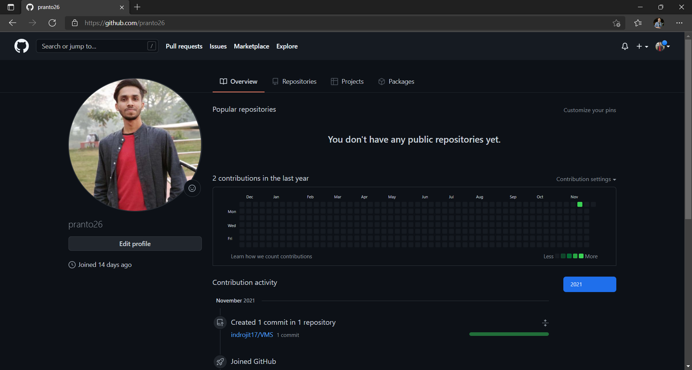

Slide 68
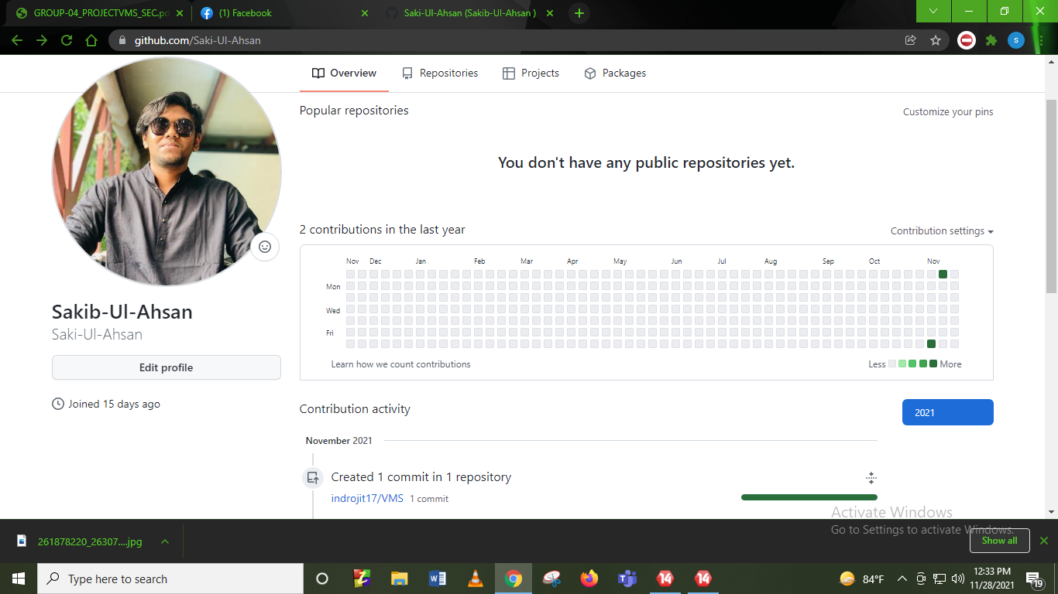

Slide 69
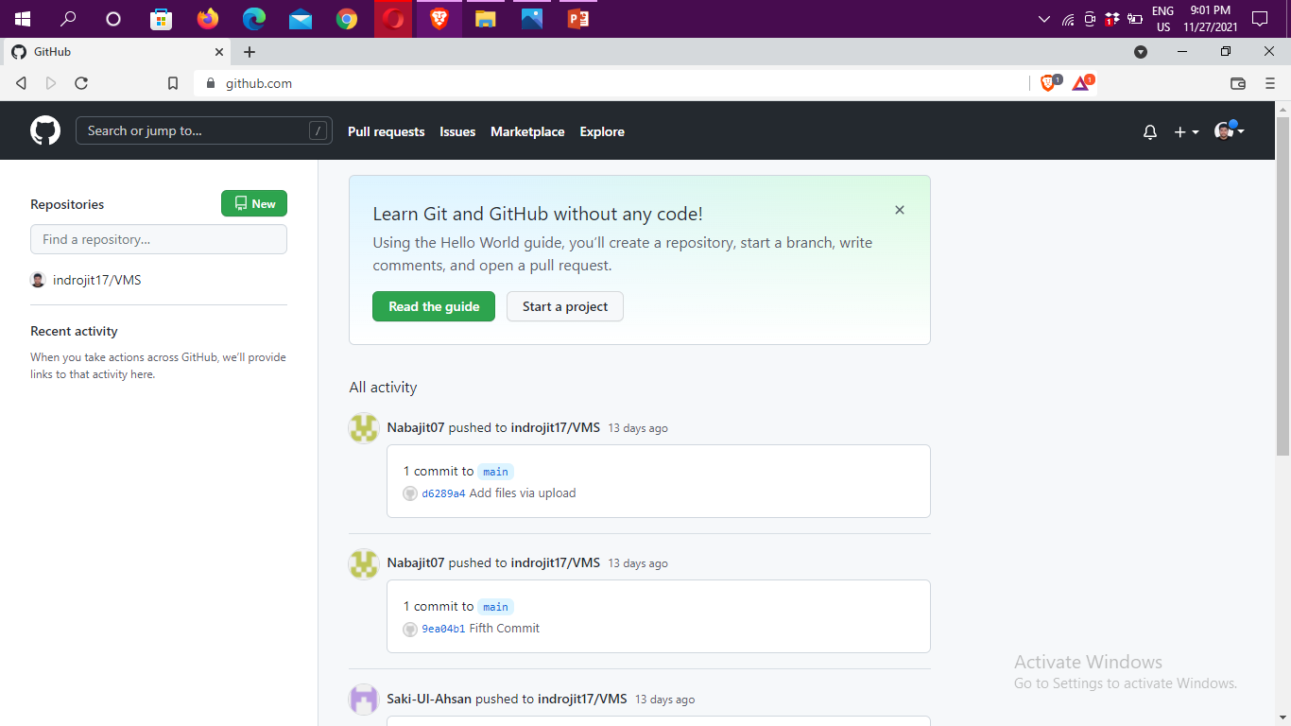

Slide 70
TABLE-LINE CHARTS

Slide 71
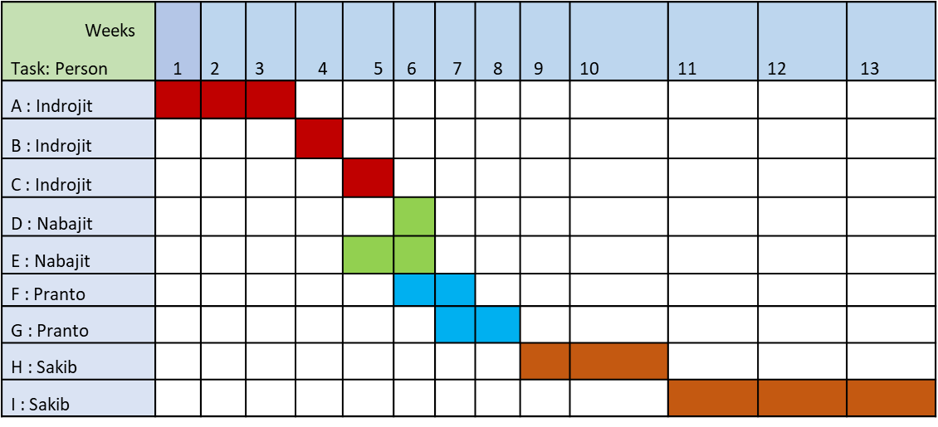

Slide 73
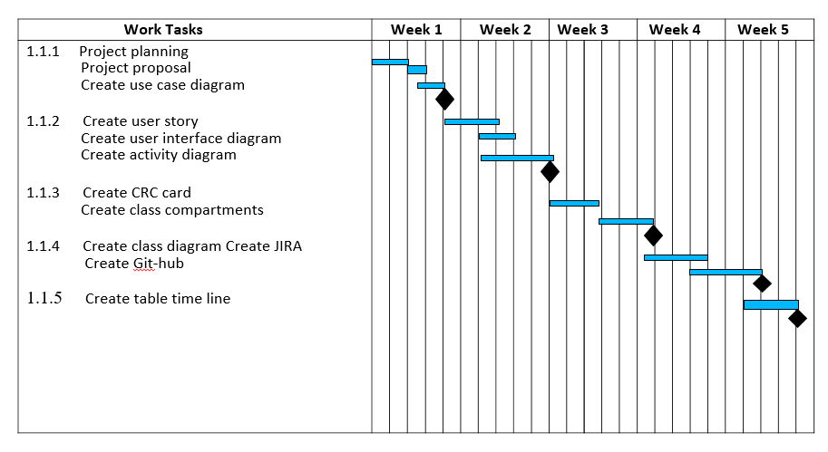

Slide 74
COCOMO & BUDGET

Slide 75
Constructive Cost Model:
Project Type : Organic
Coefficient _{<Effort Factor>} : 2.4 [P=1.05: T=0.38]
SLOC = 10,000 Lines
Person Months, PM = (2.4*10^{1.05}) = 26.93
Dev. Time, DM = (2.5*26.93^{0.38}) = 8.7 = 9 Months = 1584 Working Hours
Required people, ST = PM/DM = 3.09 = 4 People

Slide 76
Budgeting:
Developer Salary in 9 Months:
Per Developer salary Per working Hour = 500 Tk
Total Developer Salary = 500* 1584 = 792, 000 Taka
Requirement Analysis:
Time Needed: 1 month (22Working Days = 176 Working Hour)
Req. Analysis Person’s Hourly Wage = 400 Taka
Total Req. Analysis Expense = 400* 176 = 70, 400 Taka
Transport Cost Estimation: 20,000 Taka
Training and Hardware Expenses Estimation: 100, 000 Taka

Slide 77
Rent Expenses:
Room Per Month = 8,000 Taka
Total in 9 Months = 72,000 Taka
Total Utilites in 9 Months: 30,000 Taka
Maintenance (Till 9 Months after Delivery):
Expense Per Hour = 1500 Taka
Total Estimated Time Needed for Maintenance = 100 Hours
Total Estimated Maintenance Expense = 100*1500 = 150,000 Taka
Total Estimated Expense: 792,000 + 70,400 + 20,000 + 100,000 + 72,000 + 30,000 + 150,000 = 1,234,400 Taka
Profit:
20% of Total Estimated Expense = 1,234,400*20% = 246, 880 Taka
Project Budget: 1,234,400 + 246, 880 = 1,481,280 Taka

Slide 78

THANK YOU

